Slide 1
Guide to Computer Forensics and Investigations
Third Edition
Chapter 5
Processing Crime and Incident Scenes

Slide 2
Objectives
Explain the rules for digital evidence
Describe how to collect evidence at private-sector incident scenes
Explain guidelines for processing law enforcement crime scenes
List the steps in preparing for an evidence search
Describe how to secure a computer incident or crime scene
Guide to Computer Forensics and Investigations

Slide 3
Objectives (continued)
Explain guidelines for seizing digital evidence at the scene
List procedures for storing digital evidence
Explain how to obtain a digital hash
Review a case to identify requirements and plan your investigation
Guide to Computer Forensics and Investigations

Slide 4
Identifying Digital Evidence
Digital evidence
  Can be any information stored or transmitted in digital form
U.S. courts accept digital evidence as physical evidence
  Digital data is a tangible object
Some require that all digital evidence be printed out to be presented in court
Guide to Computer Forensics and Investigations

Slide 5
Identifying Digital Evidence (continued)
General tasks investigators perform when working with digital evidence:
  Identify digital information or artifacts that can be used as evidence
  Collect, preserve, and document evidence
  Analyze, identify, and organize evidence
  Rebuild evidence or repeat a situation to verify that the results can be reproduced reliably
Collecting computers and processing a criminal or incident scene must be done systematically
Guide to Computer Forensics and Investigations

Slide 6
Understanding Rules of Evidence
Consistent practices help verify your work and enhance your credibility
Comply with your state’s rules of evidence or with the Federal Rules of Evidence
Evidence admitted in a criminal case can be used in a civil suit, and vice versa
Keep current on the latest rulings and directives on collecting, processing, storing, and admitting digital evidence
Guide to Computer Forensics and Investigations

Slide 7
Understanding Rules of Evidence (continued)
Data you discover from a forensic examination falls under your state’s rules of evidence
  Or the Federal Rules of Evidence
Digital evidence is unlike other physical evidence because it can be changed more easily
  The only way to detect these changes is to compare the original data with a duplicate
Most federal courts have interpreted computer records as hearsay evidence
  Hearsay is secondhand or indirect evidence
Guide to Computer Forensics and Investigations

Slide 8
Understanding Rules of Evidence (continued)
Business-record exception
  Allows “records of regularly conducted activity,” such as business memos, reports, records, or data compilations
Generally, computer records are considered admissible if they qualify as a business record
Computer records are usually divided into:
  Computer-generated records
  Computer-stored records
Guide to Computer Forensics and Investigations

Slide 9
Understanding Rules of Evidence (continued)
Computer records must be shown to be authentic and trustworthy
  To be admitted into court
Computer-generated records are considered authentic
  If the program that created the output is functioning correctly
Collecting evidence according to the proper steps of evidence control helps ensure that the computer evidence is authentic
Guide to Computer Forensics and Investigations

Slide 10
Understanding Rules of Evidence (continued)
When attorneys challenge digital evidence
  Often they raise the issue of whether computer-generated records were altered
    Or damaged after they were created
One test to prove that computer-stored records are authentic is to demonstrate that a specific person created the records
  The author of a Microsoft Word document can be identified by using file metadata
Guide to Computer Forensics and Investigations

Slide 11
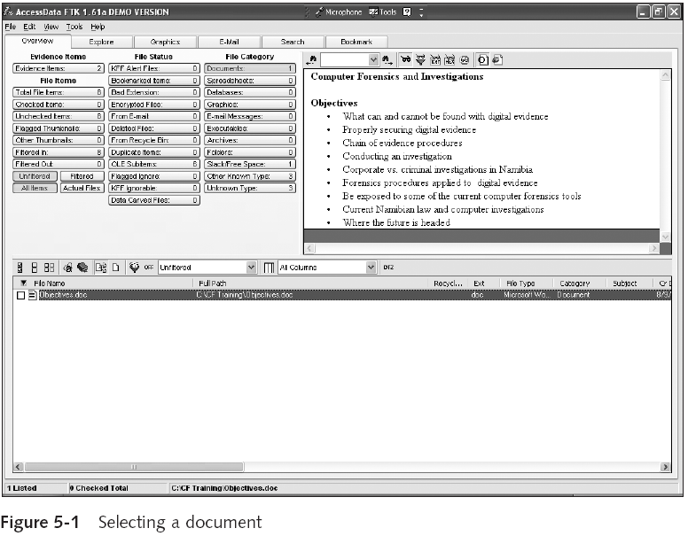
Guide to Computer Forensics and Investigations

Slide 12
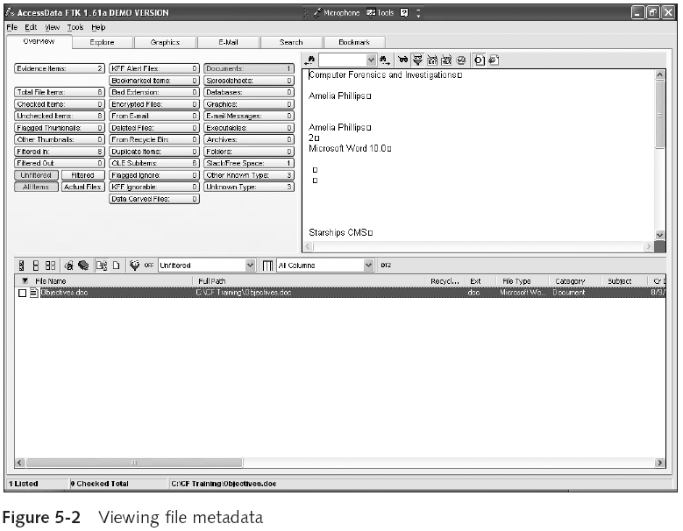
Guide to Computer Forensics and Investigations

Slide 13
Understanding Rules of Evidence (continued)
The process of establishing digital evidence’s trustworthiness originated with written documents and the best evidence rule
Best evidence rule states:
  To prove the content of a written document, recording, or photograph, ordinarily the original writing, recording, or photograph is required
Federal Rules of Evidence
  Allow a duplicate instead of originals when it is produced by the same impression as the original
Guide to Computer Forensics and Investigations

Slide 14
Understanding Rules of Evidence (continued)
As long as bit-stream copies of data are created and maintained properly
  The copies can be admitted in court, although they aren’t considered best evidence
Guide to Computer Forensics and Investigations

Slide 15
Collecting Evidence in Private-Sector Incident Scenes
Private-sector organizations include:
  Businesses and government agencies that aren’t involved in law enforcement
Agencies must comply with state public disclosure and federal Freedom of Information Act (FOIA) laws
  And make certain documents available as public records
FOIA allows citizens to request copies of public documents created by federal agencies
Guide to Computer Forensics and Investigations

Slide 16
Collecting Evidence in Private-Sector Incident Scenes (continued)
A special category of private-sector businesses includes ISPs and other communication companies
ISPs can investigate computer abuse committed by their employees, but not by customers
  Except for activities that are deemed to create an emergency situation
Investigating and controlling computer incident scenes in the corporate environment
  Much easier than in the criminal environment
  Incident scene is often a workplace
Guide to Computer Forensics and Investigations

Slide 17
Collecting Evidence in Private-Sector Incident Scenes (continued)
Typically, businesses have inventory databases of computer hardware and software
  Help identify the computer forensics tools needed to analyze a policy violation
    And the best way to conduct the analysis
Corporate policy statement about misuse of computing assets
  Allows corporate investigators to conduct covert surveillance with little or no cause
  And access company systems without a warrant
Guide to Computer Forensics and Investigations

Slide 18
Collecting Evidence in Private-Sector Incident Scenes (continued)
Companies should display a warning banner or publish a policy
  Stating that they reserve the right to inspect computing assets at will
Corporate investigators should know under what circumstances they can examine an employee’s computer
  Every organization must have a well-defined process describing when an investigation can be initiated
Guide to Computer Forensics and Investigations

Slide 19
Collecting Evidence in Private-Sector Incident Scenes (continued)
If a corporate investigator finds that an employee is committing or has committed a crime
  Employer can file a criminal complaint with the police
Employers are usually interested in enforcing company policy
  Not seeking out and prosecuting employees
Corporate investigators are, therefore, primarily concerned with protecting company assets
Guide to Computer Forensics and Investigations

Slide 20
Collecting Evidence in Private-Sector Incident Scenes (continued)
If you discover evidence of a crime during a company policy investigation
  Determine whether the incident meets the elements of criminal law
  Inform management of the incident
  Stop your investigation to make sure you don’t violate Fourth Amendment restrictions on obtaining evidence
  Work with the corporate attorney to write an affidavit confirming your findings
Guide to Computer Forensics and Investigations

Slide 21
Processing Law Enforcement Crime Scenes
You must be familiar with criminal rules of search and seizure
You should also understand how a search warrant works and what to do when you process one
Law enforcement officer may search for and seize criminal evidence only with probable cause
  Facts or circumstances that lead a reasonable person to believe a crime has been committed or is about to be committed
Guide to Computer Forensics and Investigations

Slide 22
Processing Law Enforcement Crime Scenes (continued)
With probable cause, a police officer can obtain a search warrant from a judge
  That authorizes a search and seizure of specific evidence related to the criminal complaint
The Fourth Amendment states that only warrants “particularly describing the place to be searched, and the persons or things to be seized” can be issued
Guide to Computer Forensics and Investigations

Slide 23
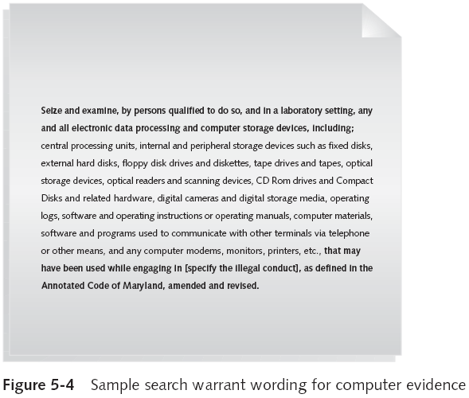
Guide to Computer Forensics and Investigations

Slide 24
Understanding Concepts and Terms Used in Warrants
Innocent information
  Unrelated information
  Often included with the evidence you’re trying to recover
Judges often issue a limiting phrase to the warrant
  Allows the police to separate innocent information from evidence
Guide to Computer Forensics and Investigations

Slide 25
Understanding Concepts and Terms Used in Warrants (continued)
Plain view doctrine
  Objects falling in plain view of an officer who has the right to be in position to have that view
    Are subject to seizure without a warrant and may be introduced in evidence
“Knock and announce”
  With few exceptions, warrants require that officers knock and announce their identity
    When executing a warrant
Guide to Computer Forensics and Investigations

Slide 26
Preparing for a Search
Preparing for a computer search and seizure
  Probably the most important step in computing investigations
To perform these tasks
  You might need to get answers from the victim and an informant
    Who could be a police detective assigned to the case, a law enforcement witness, or a manager or coworker of the person of interest to the investigation
Guide to Computer Forensics and Investigations

Slide 27
Identifying the Nature of the Case
When you’re assigned a computing investigation case
  Start by identifying the nature of the case
    Including whether it involves the private or public sector
The nature of the case dictates how you proceed
  And what types of assets or resources you need to use in the investigation
Guide to Computer Forensics and Investigations

Slide 28
Identifying the Type of Computing System
For law enforcement
  This step might be difficult because the crime scene isn’t controlled
If you can identify the computing system
  Estimate the size of the drive on the suspect’s computer
    And how many computers to process at the scene
Determine which OSs and hardware are involved
Guide to Computer Forensics and Investigations

Slide 29
Determining Whether You Can Seize a Computer
The type of case and location of the evidence
  Determine whether you can remove computers
Law enforcement investigators need a warrant to remove computers from a crime scene
  And transport them to a lab
If removing the computers will irreparably harm a business
  The computers should not be taken offsite
Guide to Computer Forensics and Investigations

Slide 30
Determining Whether You Can Seize a Computer (continued)
An additional complication is files stored offsite that are accessed remotely
If you aren’t allowed to take the computers to your lab
  Determine the resources you need to acquire digital evidence and which tools can speed data acquisition
Guide to Computer Forensics and Investigations

Slide 31
Obtaining a Detailed Description of the Location
Get as much information as you can
Identify potential hazards
  Interact with your HAZMAT team
HAZMAT guidelines
  Put the target drive in a special HAZMAT bag
  HAZMAT technician can decontaminate the bag
  Check for high temperatures
Guide to Computer Forensics and Investigations

Slide 32
Determining Who Is in Charge
Corporate computing investigations
  Require only one person to respond
Law enforcement agencies
  Handle large-scale investigations
  Designate lead investigators
Guide to Computer Forensics and Investigations

Slide 33
Using Additional Technical Expertise
Look for specialists
  OSs
  RAID servers
  Databases
Finding the right person can be a challenge
Educate specialists in investigative techniques
  Prevent evidence damage
Guide to Computer Forensics and Investigations

Slide 34
Determining the Tools You Need
Prepare tools using incident and crime scene information
Initial-response field kit
  Lightweight
  Easy to transport
Extensive-response field kit
  Includes all tools you can afford
Guide to Computer Forensics and Investigations

Slide 35
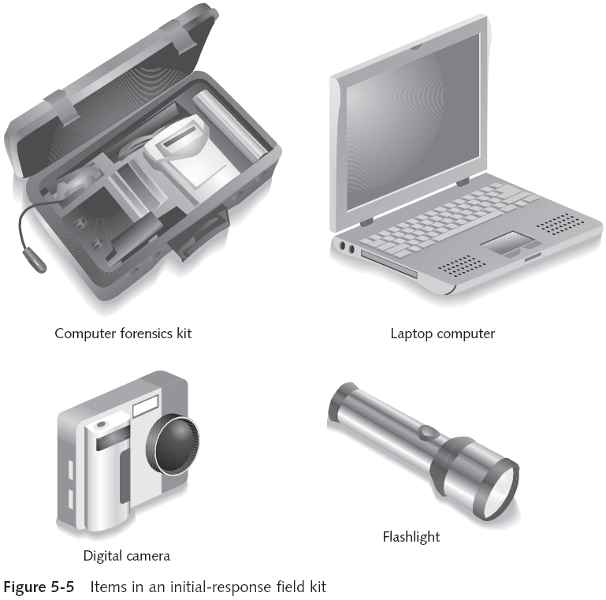
Guide to Computer Forensics and Investigations

Slide 36
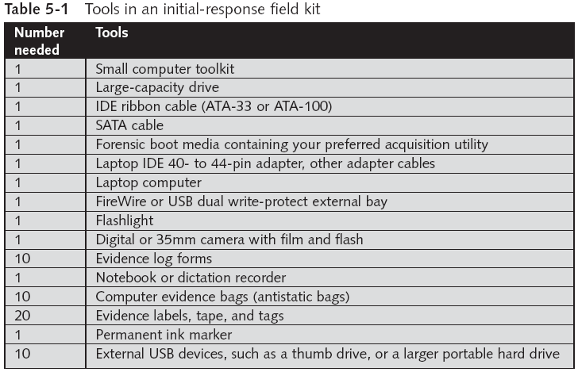
Guide to Computer Forensics and Investigations

Slide 37
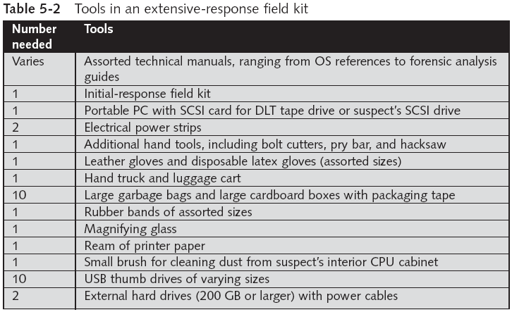
Guide to Computer Forensics and Investigations

Slide 38
Preparing the Investigation Team
Review facts, plans, and objectives with the investigation team you have assembled
Goals of scene processing
  Collect evidence
  Secure evidence
Slow response can cause digital evidence to be lost
Guide to Computer Forensics and Investigations

Slide 39
Securing a Computer Incident or Crime Scene
Goals
  Preserve the evidence
  Keep information confidential
Define a secure perimeter
  Use yellow barrier tape
  Legal authority
Professional curiosity can destroy evidence
  Involves police officers and other professionals who aren’t part of the crime scene processing team
Guide to Computer Forensics and Investigations

Slide 40
Seizing Digital Evidence at the Scene
Law enforcement can seize evidence
  With a proper warrant
Corporate investigators rarely can seize evidence
When seizing computer evidence in criminal investigations
  Follow U.S. DoJ standards for seizing digital data
Civil investigations follow same rules
  Require less documentation though
Consult with your attorney for extra guidelines
Guide to Computer Forensics and Investigations

Slide 41
Preparing to Acquire Digital Evidence
The evidence you acquire at the scene depends on the nature of the case
  And the alleged crime or violation
Ask your supervisor or senior forensics examiner in your organization the following questions:
  Do you need to take the entire computer and all peripherals and media in the immediate area?
  How are you going to protect the computer and media while transporting them to your lab?
  Is the computer powered on when you arrive?
Guide to Computer Forensics and Investigations

Slide 42
Preparing to Acquire Digital Evidence (continued)
Ask your supervisor or senior forensics examiner in your organization the following questions (continued):
  Is the suspect you’re investigating in the immediate area of the computer?
  Is it possible the suspect damaged or destroyed the computer, peripherals, or media?
  Will you have to separate the suspect from the computer?
Guide to Computer Forensics and Investigations

Slide 43
Processing an Incident or Crime Scene
Guidelines
  Keep a journal to document your activities
  Secure the scene
    Be professional and courteous with onlookers
    Remove people who are not part of the investigation
  Take video and still recordings of the area around the computer
    Pay attention to details
  Sketch the incident or crime scene
  Check computers as soon as possible
Guide to Computer Forensics and Investigations

Slide 44
Processing an Incident or Crime Scene (continued)
Guidelines (continued)
  Don’t cut electrical power to a running system unless it’s an older Windows 9x or MS-DOS system
  Save data from current applications as safely as possible
  Record all active windows or shell sessions
  Make notes of everything you do when copying data from a live suspect computer
  Close applications and shut down the computer
Guide to Computer Forensics and Investigations

Slide 45
Processing an Incident or Crime Scene (continued)
Guidelines (continued)
  Bag and tag the evidence, following these steps:
    Assign one person to collect and log all evidence
    Tag all evidence you collect with the current date and time, serial numbers or unique features, make and model, and the name of the person who collected it
    Maintain two separate logs of collected evidence
    Maintain constant control of the collected evidence and the crime or incident scene
Guide to Computer Forensics and Investigations

Slide 46
Processing an Incident or Crime Scene (continued)
Guidelines (continued)
  Look for information related to the investigation
    Passwords, passphrases, PINs, bank accounts
  Collect documentation and media related to the investigation
    Hardware, software, backup media, documentation, manuals
Guide to Computer Forensics and Investigations

Slide 47
Processing Data Centers with RAID Systems
Sparse acquisition
  Technique for extracting evidence from large systems
  Extracts only data related to evidence for your case from allocated files
    And minimizes how much data you need to analyze
Drawback of this technique
  It doesn’t recover data in free or slack space
Guide to Computer Forensics and Investigations

Slide 48
Using a Technical Advisor
Technical advisor
  Can help you list the tools you need to process the incident or crime scene
  Person guiding you about where to locate data and helping you extract log records
    Or other evidence from large RAID servers
  Can help create the search warrant by itemizing what you need for the warrant
Guide to Computer Forensics and Investigations

Slide 49
Using a Technical Advisor (continued)
Responsibilities
  Know aspects of the seized system
  Direct investigator handling sensitive material
  Help secure the scene
  Help document the planning strategy
  Conduct ad hoc trainings
  Document activities
Guide to Computer Forensics and Investigations

Slide 50
Documenting Evidence in the Lab
Record your activities and findings as you work
  Maintain a journal to record the steps you take as you process evidence
Goal is to be able to reproduce the same results
  When you or another investigator repeat the steps you took to collect evidence
A journal serves as a reference that documents the methods you used to process digital evidence
Guide to Computer Forensics and Investigations

Slide 51
Processing and Handling Digital Evidence
Maintain the integrity of digital evidence in the lab
  As you do when collecting it in the field
Steps to create image files:
  Copy all image files to a large drive
  Start your forensics tool to analyze the evidence
  Run an MD5 or SHA-1 hashing algorithm on the image files to get a digital hash
  Secure the original media in an evidence locker
Guide to Computer Forensics and Investigations

Slide 52
Storing Digital Evidence
The media you use to store digital evidence usually depends on how long you need to keep it
CD-Rs or DVDs
  The ideal media
  Capacity: up to 17 GB
  Lifespan: 2 to 5 years
Magnetic tapes
  Capacity: 40 to 72 GB
  Lifespan: 30 years
  Costs: drive: $400 to $800; tape: $40
Guide to Computer Forensics and Investigations

Slide 53
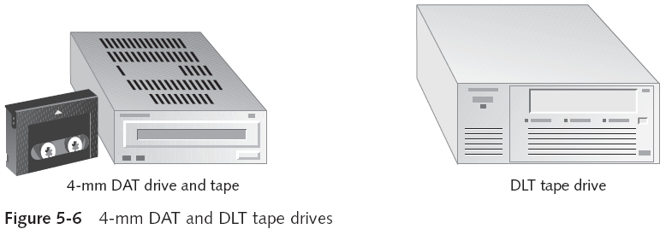
Storing Digital Evidence (continued)
Guide to Computer Forensics and Investigations

Slide 54
Evidence Retention and Media Storage Needs
To help maintain the chain of custody for digital evidence
  Restrict access to lab and evidence storage area
Lab should have a sign-in roster for all visitors
  Maintain logs for a period based on legal requirements
You might need to retain evidence indefinitely
  Check with your local prosecuting attorney’s office or state laws to make sure you’re in compliance
Guide to Computer Forensics and Investigations

Slide 55
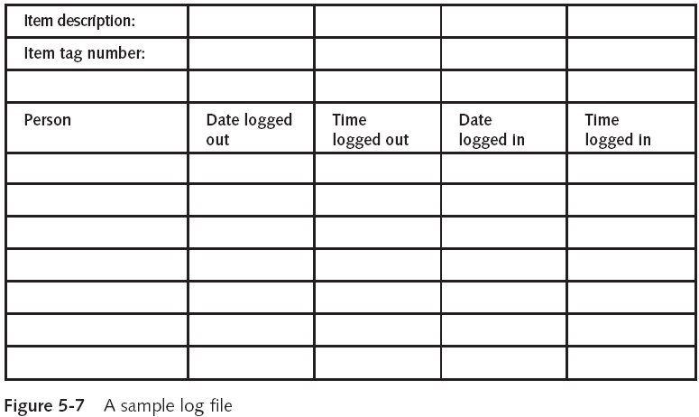
Evidence Retention and Media Storage Needs (continued)
Guide to Computer Forensics and Investigations

Slide 56
Documenting Evidence
Create or use an evidence custody form
An evidence custody form serves the following functions:
  Identifies the evidence
  Identifies who has handled the evidence
  Lists dates and times the evidence was handled
You can add more information to your form
  Such as a section listing MD5 and SHA-1 hash values
Guide to Computer Forensics and Investigations

Slide 57
Documenting Evidence (continued)
Include any detailed information you might need to reference
Evidence bags also include labels or evidence forms you can use to document your evidence
Guide to Computer Forensics and Investigations

Slide 58
Obtaining a Digital Hash
Cyclic Redundancy Check (CRC)
  Mathematical algorithm that determines whether a file’s contents have changed
  Most recent version is CRC-32
  Not considered a forensic hashing algorithm
Message Digest 5 (MD5)
  Mathematical formula that translates a file into a hexadecimal code value, or a hash value
  If a bit or byte in the file changes, it alters the digital hash
Guide to Computer Forensics and Investigations

Slide 59
Obtaining a Digital Hash (continued)
Three rules for forensic hashes:
  You can’t predict the hash value of a file or device
  No two hash values can be the same
  If anything changes in the file or device, the hash value must change
Secure Hash Algorithm version 1 (SHA-1)
  A newer hashing algorithm
  Developed by the National Institute of Standards and Technology (NIST)
Guide to Computer Forensics and Investigations

Slide 60
Obtaining a Digital Hash (continued)
In both MD5 and SHA-1, collisions have occurred
Most computer forensics hashing needs can be satisfied with a nonkeyed hash set
  A unique hash number generated by a software tool, such as the Linux md5sum command
Keyed hash set
  Created by an encryption utility’s secret key
You can use the MD5 function in FTK Imager to obtain the digital signature of a file
  Or an entire drive
Guide to Computer Forensics and Investigations

Slide 61
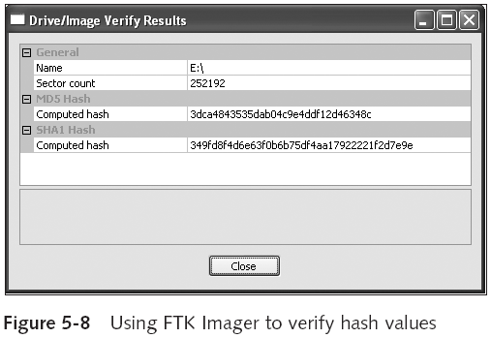
Obtaining a Digital Hash (continued)
Guide to Computer Forensics and Investigations

Slide 62
Reviewing a Case
General tasks you perform in any computer forensics case:
  Identify the case requirements
  Plan your investigation
  Conduct the investigation
  Complete the case report
  Critique the case
Guide to Computer Forensics and Investigations

Slide 63
Sample Civil Investigation
Most cases in the corporate environment are considered low-level investigations
  Or noncriminal cases
Common activities and practices
  Recover specific evidence
    Suspect’s Outlook e-mail folder (PST file)
  Covert surveillance
    Its use must be well defined in the company policy
    Risk of civil or criminal liability
  Sniffing tools for data transmissions
Guide to Computer Forensics and Investigations

Slide 64
Sample Criminal Investigation
Computer crimes examples
  Fraud
  Check fraud
  Homicides
Need a warrant to start seizing evidence
  Limit searching area
Guide to Computer Forensics and Investigations

Slide 65
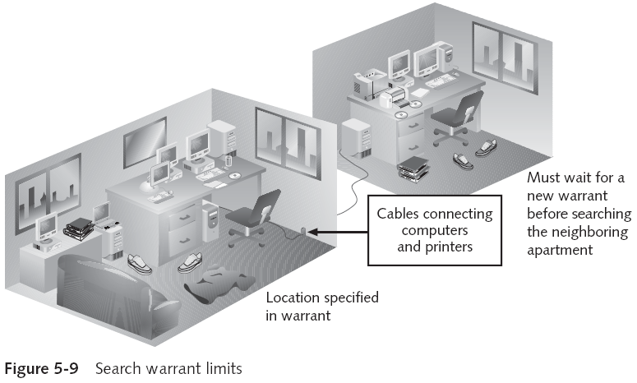
Sample Criminal Investigation (continued)
Guide to Computer Forensics and Investigations

Slide 66
Reviewing Background Information for a Case
Company called Superior Bicycles
  Specializes in creating new and inventive modes of human-driven transportation
Two employees, Chris Murphy and Nau Tjeriko, have been missing for several days
A USB thumb drive has been recovered from Chris’s office with evidence that he had been conducting a side business using company computers
Guide to Computer Forensics and Investigations

Slide 67
Identifying the Case Requirements
Identify requirements such as:
  Nature of the case
  Suspect’s name
  Suspect’s activity
  Suspect’s hardware and software specifications
Guide to Computer Forensics and Investigations

Slide 68
Planning Your Investigation
List what you can assume or know
  Several incidents may or may not be related
  Suspect’s computer can contain information about the case
  If someone else has used suspect’s computer
Make an image of suspect’s computer disk drive
Analyze forensics copy
Guide to Computer Forensics and Investigations

Slide 69
Conducting the Investigation: Acquiring Evidence with AccessData FTK
Functions
  Extract the image from a bit-stream image file
  Analyze the image
Guide to Computer Forensics and Investigations

Slide 70
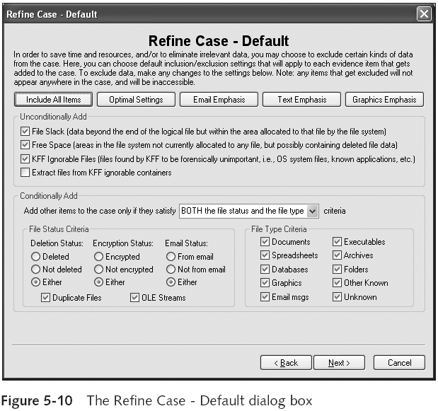
Guide to Computer Forensics and Investigations

Slide 71
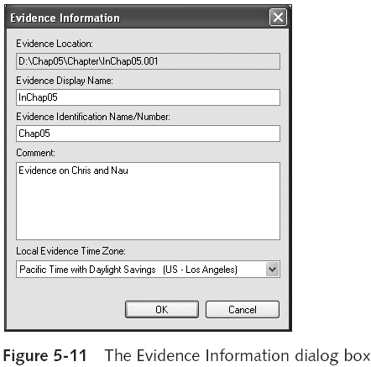
Conducting the Investigation: Acquiring Evidence with AccessData FTK (continued)
Guide to Computer Forensics and Investigations

Slide 72
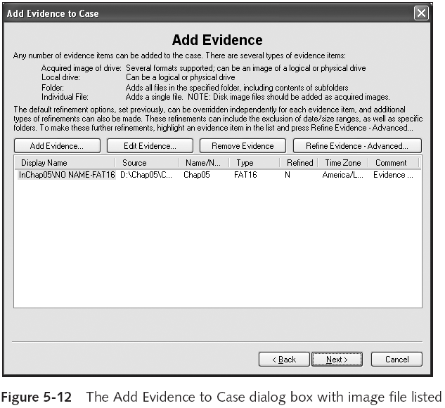
Guide to Computer Forensics and Investigations

Slide 73
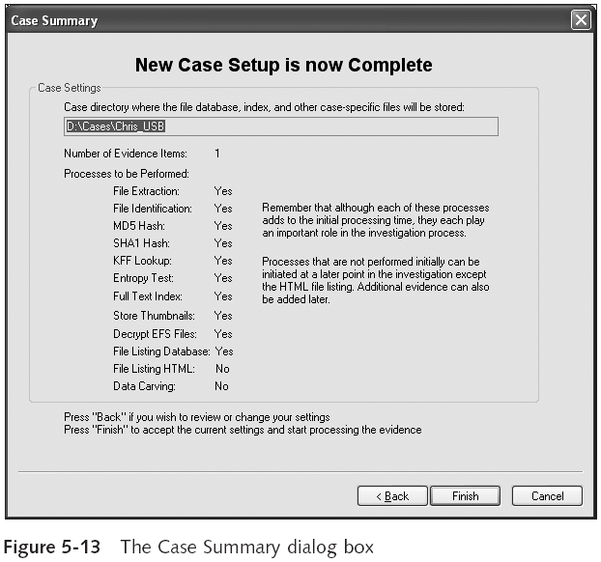
Guide to Computer Forensics and Investigations

Slide 74
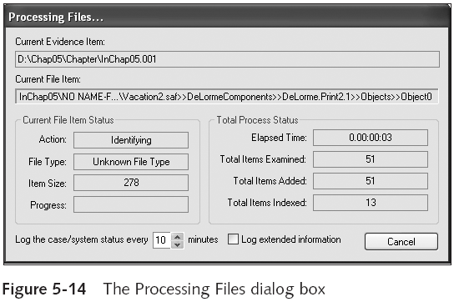
Conducting the Investigation: Acquiring Evidence with AccessData FTK (continued)
Guide to Computer Forensics and Investigations

Slide 75
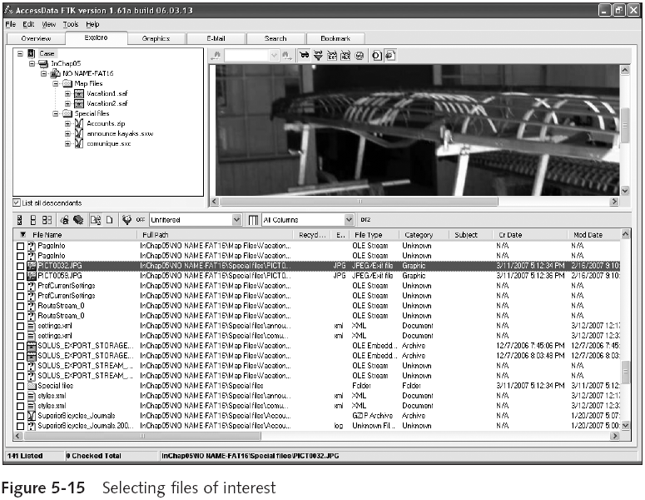
Guide to Computer Forensics and Investigations

Slide 76
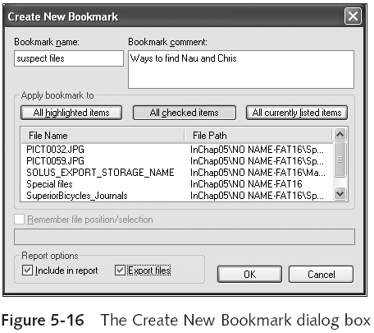
Conducting the Investigation: Acquiring Evidence with AccessData FTK (continued)
Guide to Computer Forensics and Investigations

Slide 77
Summary
Digital evidence is anything stored or transmitted on electronic or optical media
Private sector
  Contained and controlled area
Publish right to inspect computer assets policy
Private and public sectors follow same computing investigation rules
Criminal cases
  Require warrants
Guide to Computer Forensics and Investigations

Slide 78
Summary (continued)
Protect your safety and health as well as the integrity of the evidence
Follow guidelines when processing an incident or crime scene
  Security perimeter
  Video recording
As you collect digital evidence, guard against physically destroying or contaminating it
Forensic hash values verify that data or storage media have not been altered
Guide to Computer Forensics and Investigations

Slide 79
Summary (continued)
To analyze computer forensics data, learn to use more than one vendor tool
You must handle all evidence the same way every time you handle it
After you determine that an incident scene has digital evidence, identify the digital information or artifacts that can be used as evidence
Guide to Computer Forensics and Investigations

